Slide 1


Pharmaceutical Sales Data Analysis
Team Members:
Joseph Maher
From Raw Data to Actionable Business Insights
Kholoud Rashad
Ahmed Ashraf
Yehia Elhaytham
Graduation Project Presentation
Nourhan Hashad

Slide 2


Presentation Outline:
A Structured Approach to Data-Driven Insights
Stage 1:Project Introduction: Data Source and Data Overview
Stage 2: Each Team Member Role
Stage 3: Data Cleaning Using Excel and SQL
Stage 4: Building Table`s Relations Using Power Pivot
Stage 5: Exploratory Data Analysis and Aggregation in Excel
Stage 6: Visualizing Key Trends with Excel Charts
Stage 7: Interactive Business Intelligence with Power BI
Stage 8: Key Insights & Recommendations

Slide 3

Acknowledgement and Appreciation
This project was conducted under the guidance and support of the **DEPI Team**. We extend our sincere gratitude for the invaluable resources and framework provided.
A special thank you to our helpful and
excellent instructor, Menna Selim , for her continuous mentorship and expertise throughout this graduation project.
- The Project Team

Slide 4
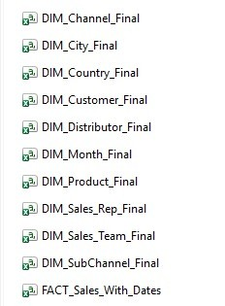
Stage 1:Project Introduction: Data Source and Data Overview
Data source : Google datasets
Data overview :
Dataset consists of 11 sheets describing global market sales of 10
pharmaceutical products over 3 years 2022-2023-2024
It also show sales in different regions , countries & cities
It also shows sales of each distributor , channels , sub –channels & customers
Sales of Sales reps & managers

Slide 5
Stage 2: Each Team Member Role
Joseph Maher:
Data cleaning with Excel ( Power Query , Power Pivot , Pivot tables )
Kholoud Rashad :
Data cleaning with SQL
Ahmed Ashraf :
Dashboard design using Power BI
Yehia Elhaytham :
Dashboard design using Power BI
Nourhan Hashad :
Data Insights & Recommendations + Project presentation

Slide 6
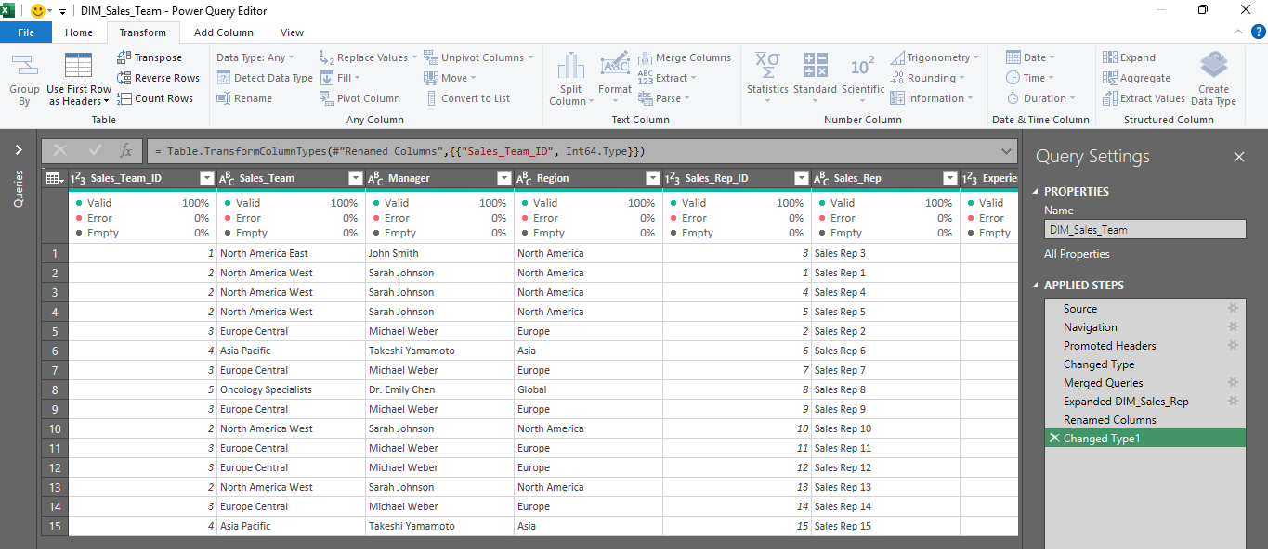
Stage 3: Data Cleaning Process
Using Excel
We start importing sheets to Power Query to start Data cleaning :
Check data types
Replace nulls
Capitalize words
Trim spaces
Remove duplicates

Slide 7
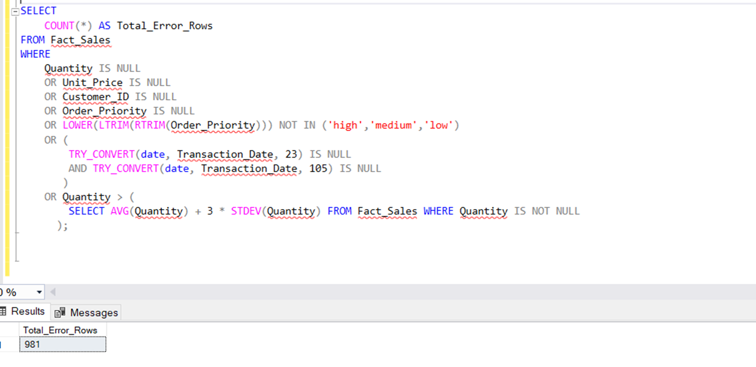
Stage 3: Data Cleaning Process
Using SQL
Data Upload
Initial Data Inspection: identified a total of 981 rows

Slide 8
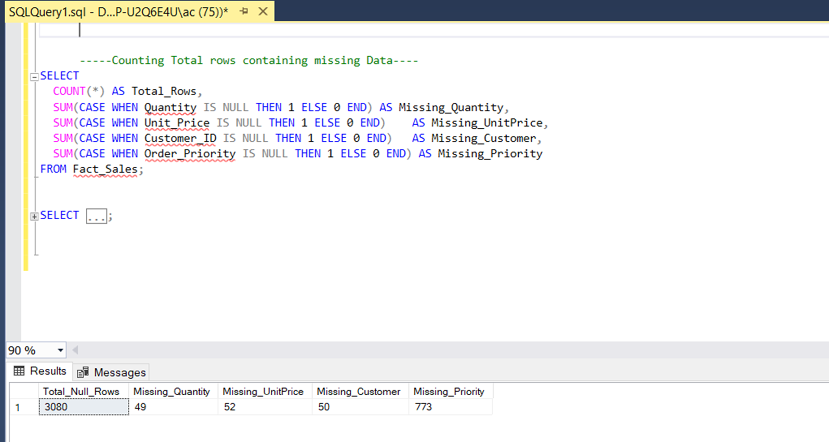
Stage 3: Data Cleaning Process
Using SQL
Counting Nulls in Data ( order priority , Quantity , Unit price, CustomerID) and we found:
773 nulls in order priority, 49 nulls in quantity, 52 nulls in uint price, 50 nulls in CustomerID.

Slide 9
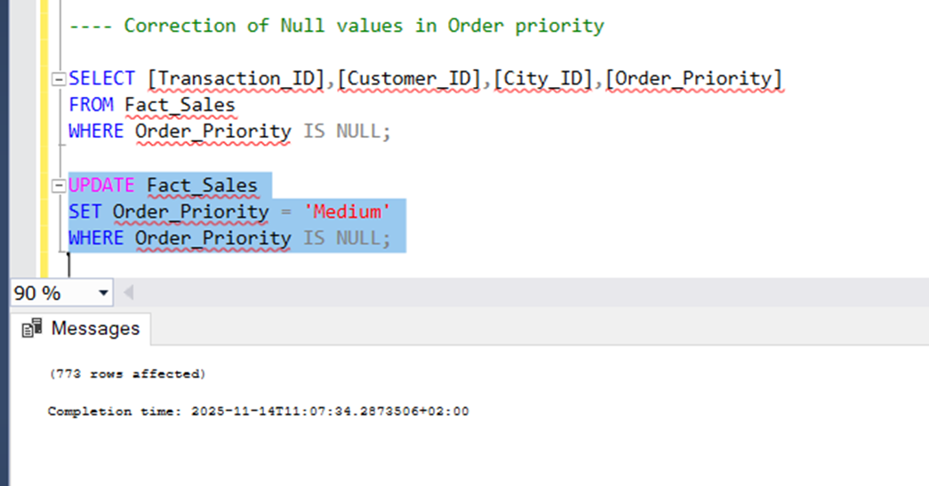
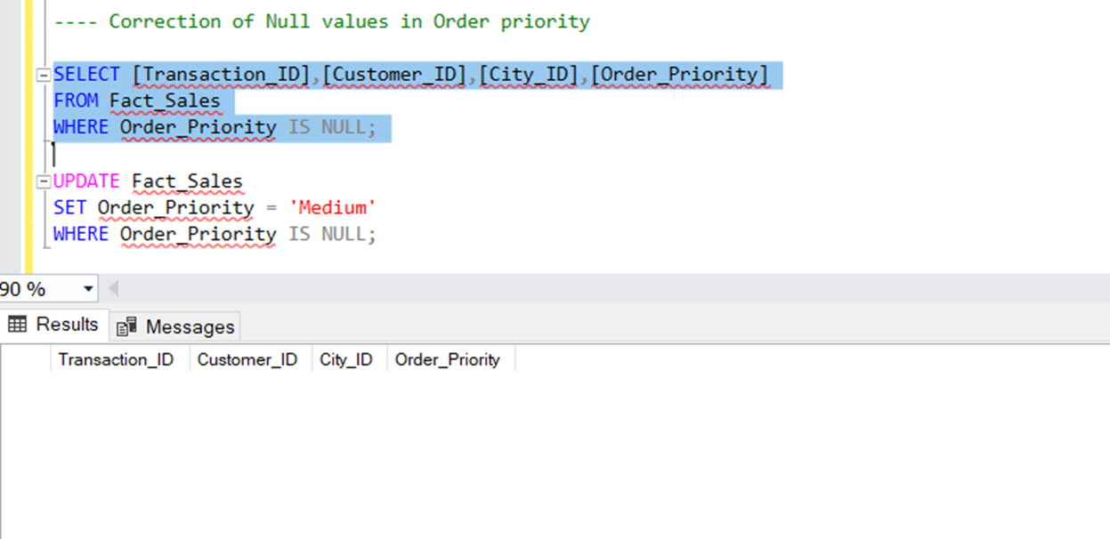
Stage 3: Data Cleaning Process
Using SQL
Fixing Null Values (Missing Data)
Order_Priority (773 rows): Replaced null values with 'Medium' priority.
UPDATE Fact _Sales SET Order_Priority = 'Medium' WHERE Order_Priority IS NULL
Validation of Null removal
Select Order_priority , CustomerID from Fact Sales where order_Priority is NULL (EMPTY)

Slide 10
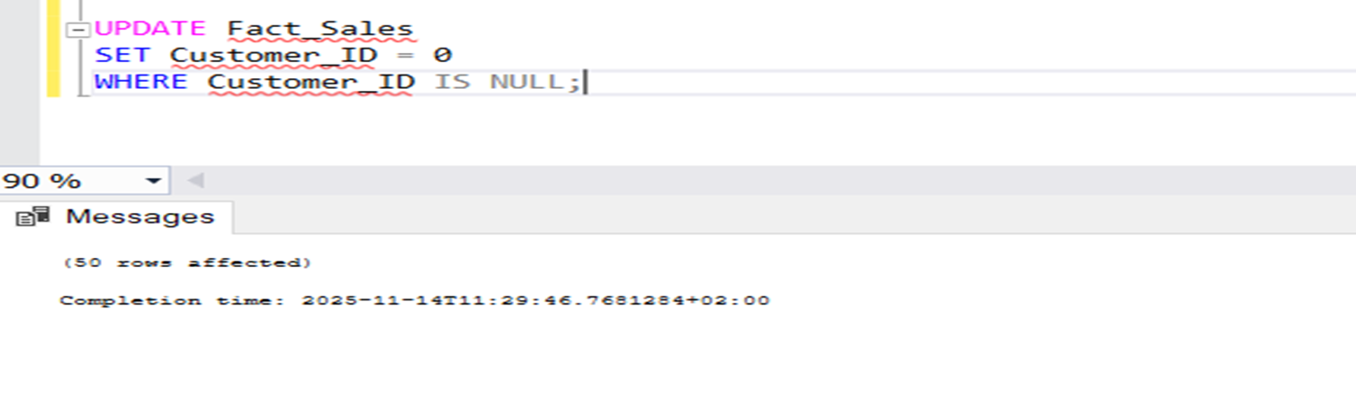
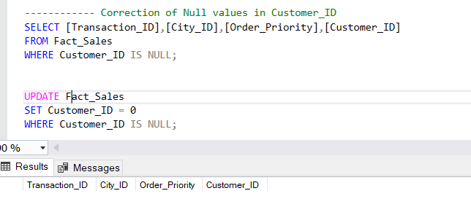
Stage 3: Data Cleaning Process
Using SQL
Fixing null values in CustomerID
(50 rows): Replaced null values with (0)
UPDATE Fact_Sales SET Customer_ID = 0 WHERE Customer_ID IS NULL
Validation of null removal
Select Order_priority , CustomerID from Fact_Sales where CustomerID is NULL (EMPTY)

Slide 11
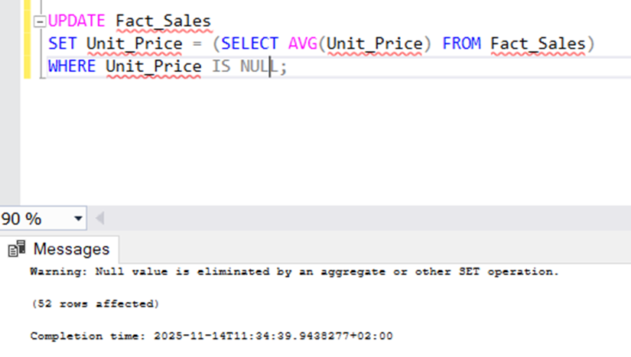
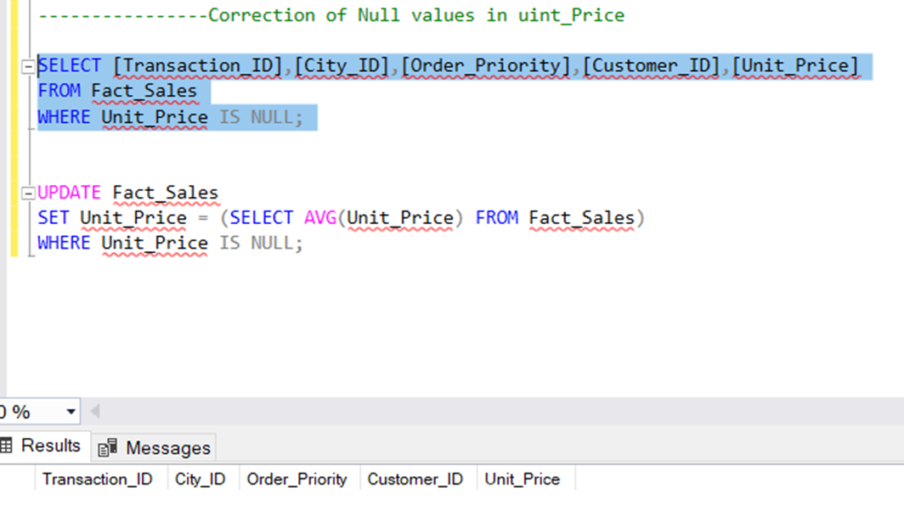
Stage 3: Data Cleaning Process
Using SQL
Fixing null Values in unit price
(52 rows): Replaced null values with the average Unit Price of the dataset
UPDATE Fact_Sales SET Unit_Price = (SELECT AVG (Unit_Price) FROM Fact_Sales) WHERE Unit_Price IS NULL
Validation of null removal
Select Order_priority , unit price from Fact_Sales where uint price is NULL (EMPTY)

Slide 12
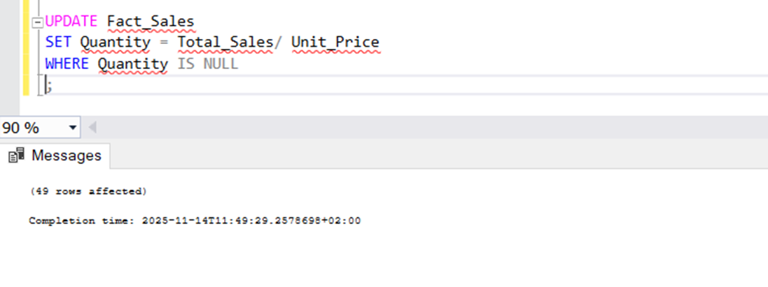
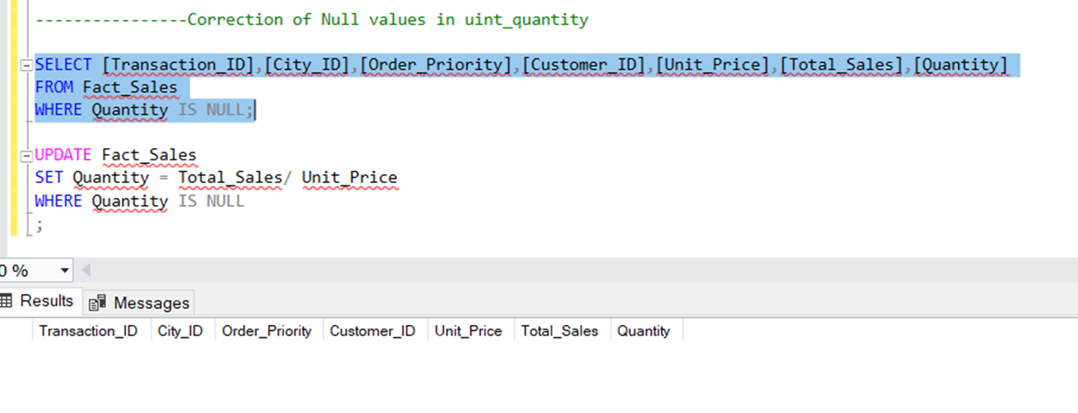
Stage 3: Data Cleaning Process
Using SQL
Fixing Null Values in unit Quantity
(49 rows): Replaced null values using formula Total Sales / Unit Price
UPDATE Fact_Sales SET Quantity = Total_Sales / Unit_Price WHERE Quantity IS NULL
Validation of Null removal
Select Order_priority , unit quantity from Fact_Sales where uint quantity is NULL (EMPTY)

Slide 13
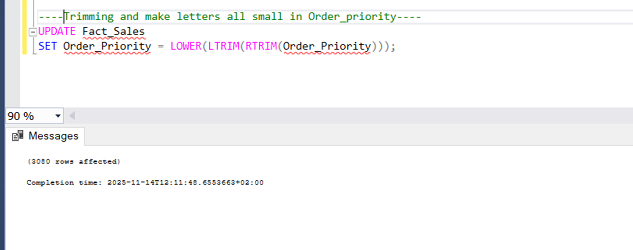
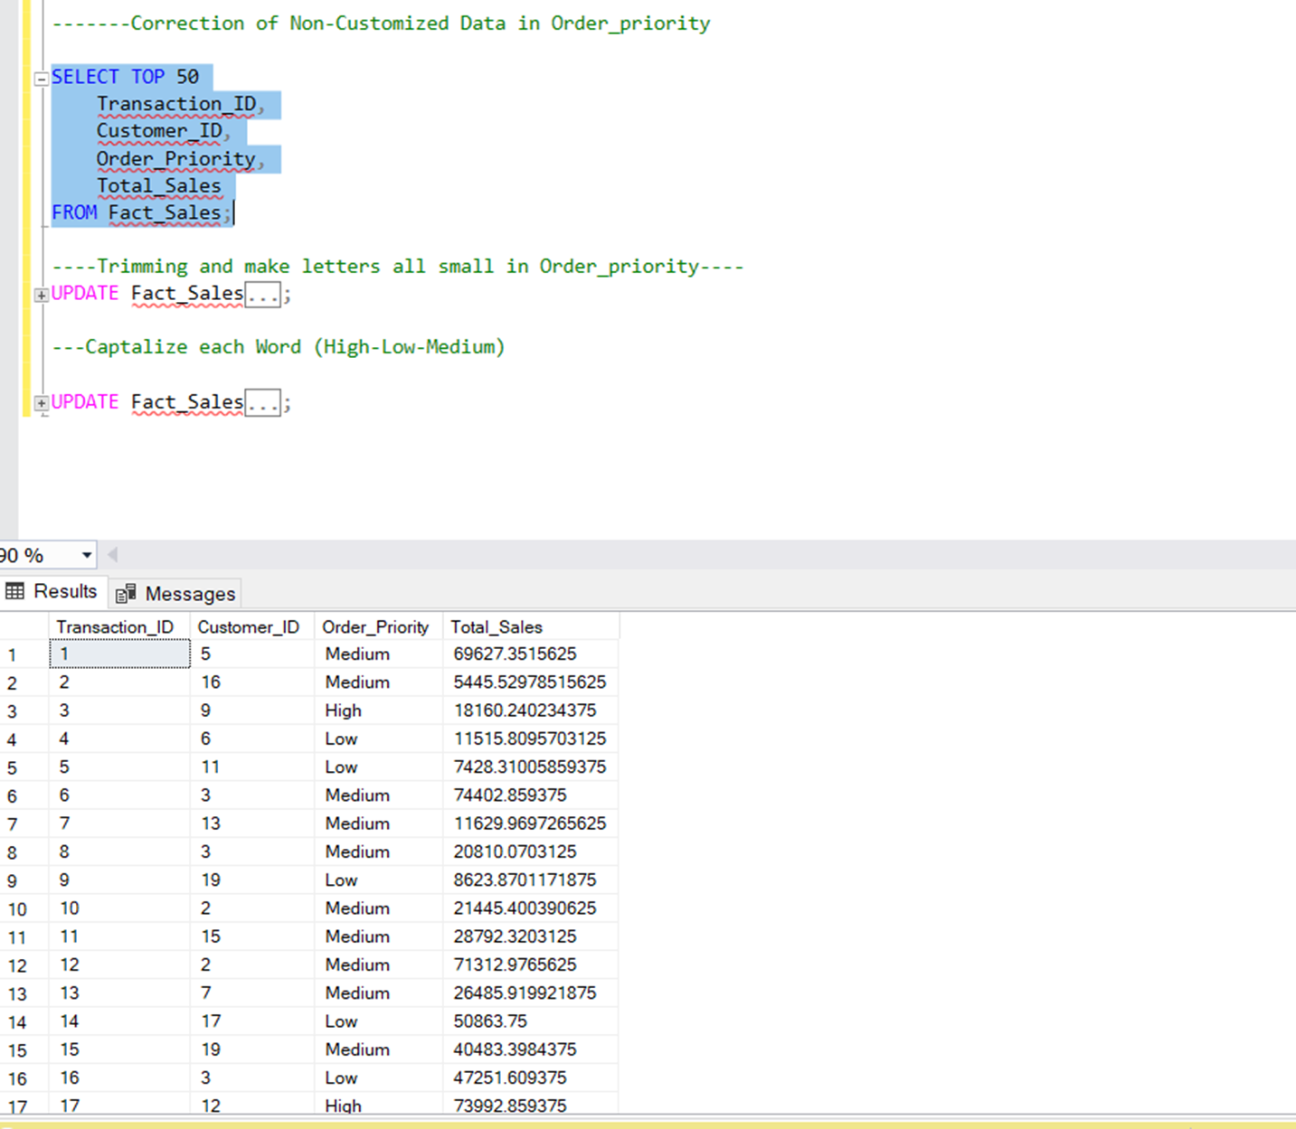
Stage 3: Data Cleaning Process
Using SQL
Data Standardization (Text Formatting)
Trimming and Lowercasing: UPDATE Fact_Sales
SET Order_Priority = LOWER(LTRIM(RTRIM(Order_Priority)))

Slide 14
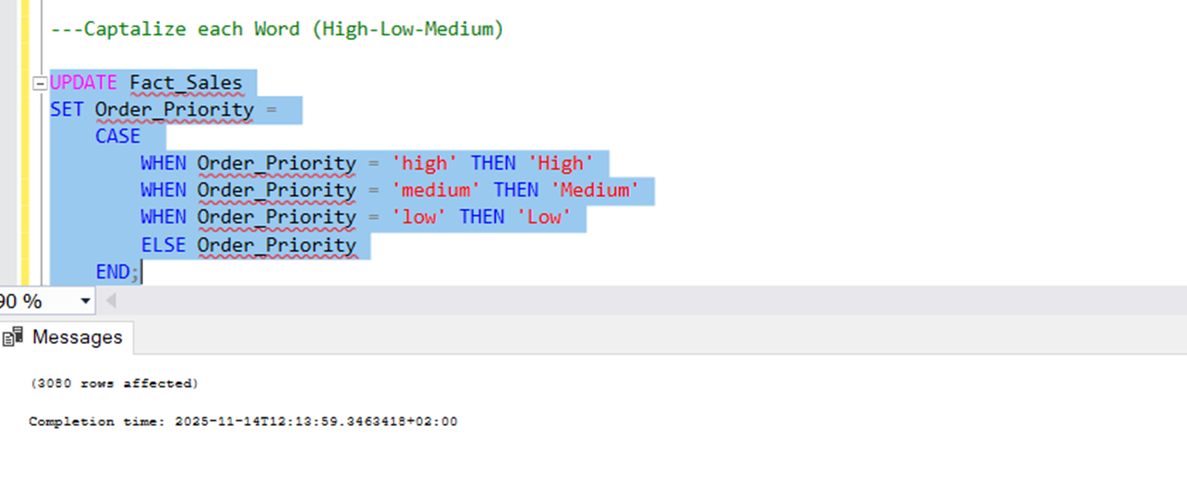
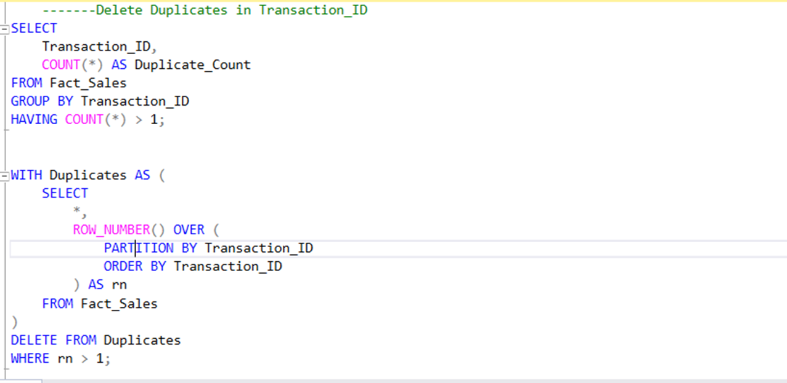
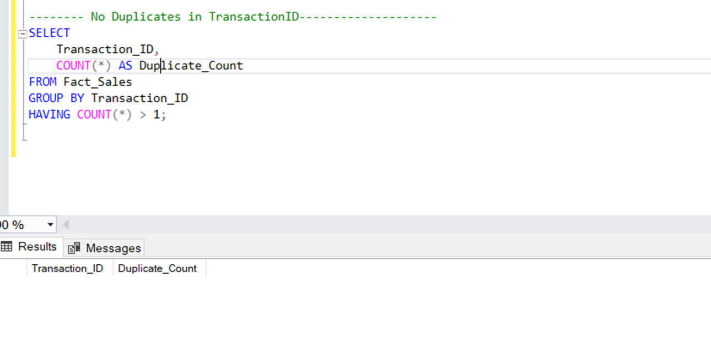
Stage 3: Data Cleaning Process
Using SQL
Capitalization: capitalize the first letter of each Order Priority value (e.g., 'high' → 'High’).
Removing Duplicates
Validation there is no Duplicates in TransactionID

Slide 15
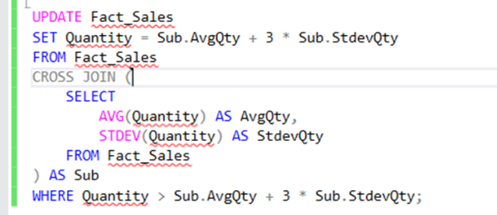
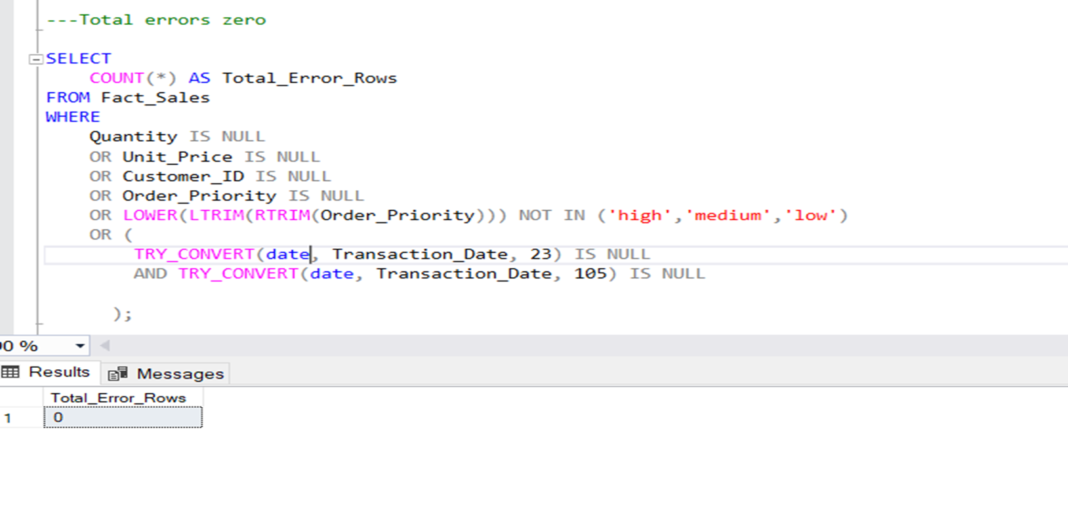
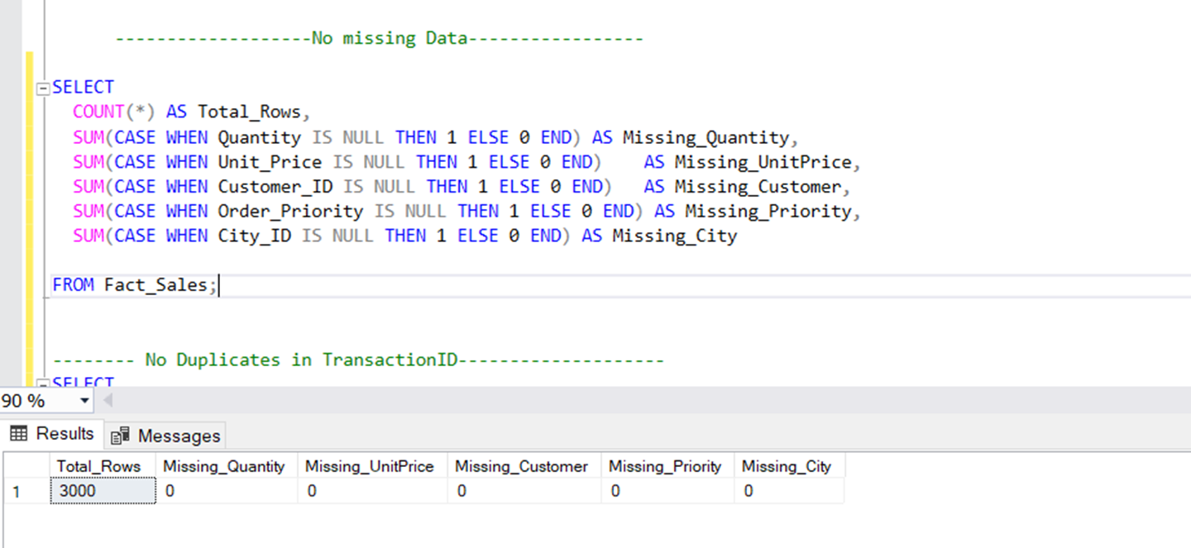
Stage 3: Data Cleaning Process
Using SQL
Managing Outliers
capping values that were more than 3 standard deviations above the mean.
Outliers were reset to the value of Average Quantity + 3 times Standard Deviation
Validation of no error Rows

Slide 16
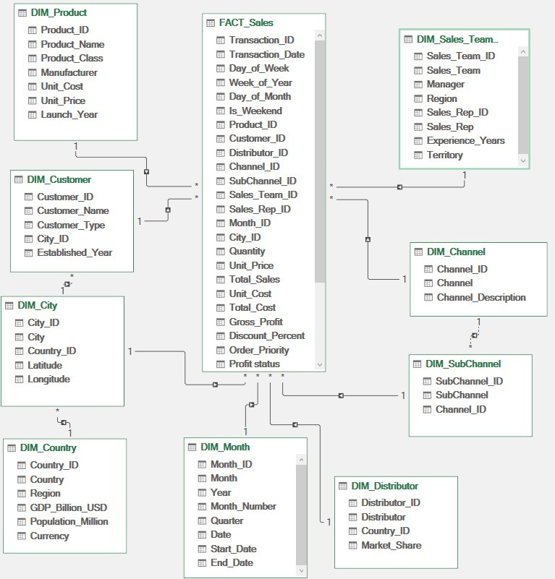
Stage 4: Building Relational Databases Using Power Pivot
After Data cleaning & validation, we start to build relations between Fact table & Dimensional tables using Power Pivots “ Star Schema“

Slide 17
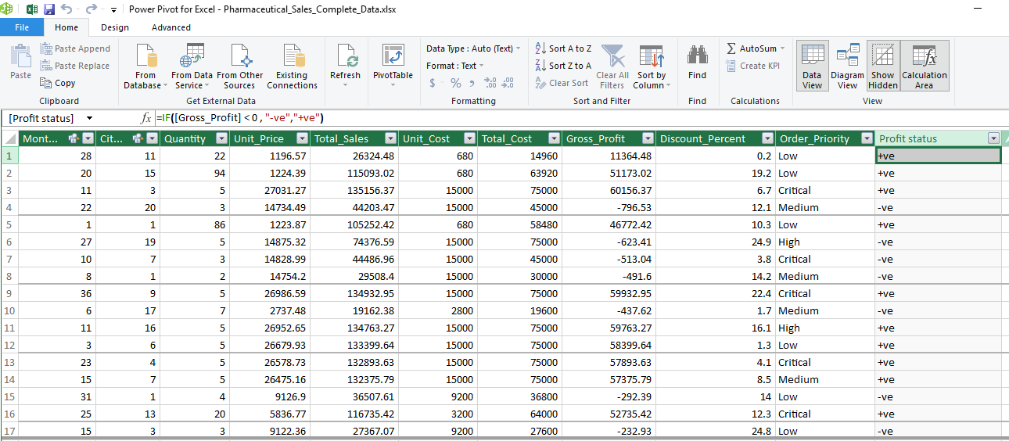
Stage 4: Building Relational Databases Using Power Pivot
We add measure in Power Pivot to describe –ve profit & +ve profit values

Slide 18
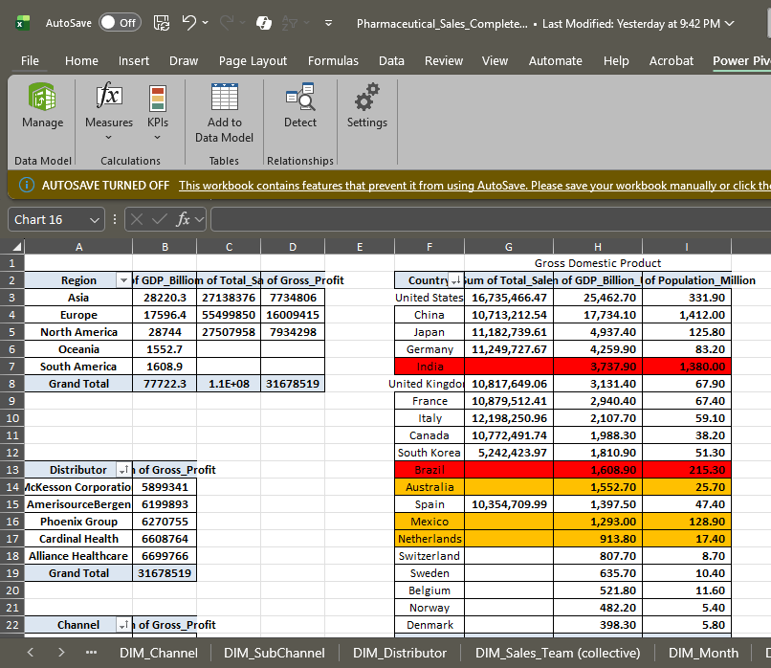
Stage 5: Exploratory Data Analysis and Aggregation in Excel
Start creating pivot tables & dig more in data insights

Slide 19
Stage 5: Exploratory Data Analysis and Aggregation in Excel
We find data denormalization as all sales reps appear below each manager causing misleading output
We return to Power query & merge both sales rep & managers tables & error fixed as shown:
Manager | Sales_Rep | Sum of Total_Sales
Dr. Emily Chen | Sales Rep 1 | 1,762,769
 | Sales Rep 10 | 1,962,148
 | Sales Rep 11 | 1,255,060
 | Sales Rep 12 | 1,489,182
 | Sales Rep 13 | 1,149,911
 | Sales Rep 14 | 1,361,877
 | Sales Rep 15 | 1,710,374
 | Sales Rep 2 | 1,804,234
 | Sales Rep 3 | 1,626,374
 | Sales Rep 4 | 1,485,910
 | Sales Rep 5 | 1,174,995
 | Sales Rep 6 | 1,306,835
 | Sales Rep 7 | 1,750,594
 | Sales Rep 8 | 1,065,781
 | Sales Rep 9 | 1,437,706
John Smith | Sales Rep 1 | 1,296,761
 | Sales Rep 10 | 1,176,296
 | Sales Rep 11 | 1,255,539
 | Sales Rep 12 | 1,200,454
 | Sales Rep 13 | 1,270,569
 | Sales Rep 14 | 1,270,415
 | Sales Rep 15 | 1,905,084
 | Sales Rep 2 | 1,734,233
 | Sales Rep 3 | 1,471,626
 | Sales Rep 4 | 1,224,084
 | Sales Rep 5 | 1,367,823
 | Sales Rep 6 | 1,736,418
 | Sales Rep 7 | 1,089,145
 | Sales Rep 8 | 1,284,062
 | Sales Rep 9 | 1,281,132
Manager | Sales_Rep
Dr. Emily Chen
 | Sales Rep 8
John Smith
 | Sales Rep 3
Michael Weber
 | Sales Rep 11
 | Sales Rep 12
 | Sales Rep 14
 | Sales Rep 2
 | Sales Rep 7
 | Sales Rep 9
Sarah Johnson
 | Sales Rep 1
 | Sales Rep 10
 | Sales Rep 13
 | Sales Rep 4
 | Sales Rep 5
Takeshi Yamamoto
 | Sales Rep 15
 | Sales Rep 6

Slide 20
Stage 6: Visualizing Key Trends with Excel Charts

Slide 21

Stage 7: Interactive Business Intelligence with Power BI

Slide 22
Stage 8: Key Insights & Recommendations
What are the Products that Selling Best? (Product and Portfolio Insights)
Oncology (Cancer drugs) is the biggest earner. It makes up almost half (47.23%) of all product sales by value.
Oncology generates the highest total sales and the most profit by a large margin.
The top two products driving the most sales and profit are Revlimid and Ozempic.
The Government channel is a very important way to sell products.
How is the Business Doing Overall? (Overall Performance and Trend Insights)
Sales and Profit are going up over the years (2022 to 2024).
Note: The Gross Profit was slightly lower in 2023 than in 2022 and 2024 “the least number of sold units was in 2023”.
The company sells a very high number of products (141,000 units sold).
The manufacturer Bristol provides the highest-profit products, followed by Merck.
McKesson Corp is top seller distributor in 2022 and then start to decline in 2023 and 2024.

Slide 23
Stage 8: Key Insights & Recommendations
Who are the Top Performers? (Sales Team Effectiveness Insights)
Michael Weber is the Top Manager. He brings in the largest share of the profit (38.51%).
Sales Rep 10 is the Best Seller. They are consistently a top performer over the three years.
Manager profit can change a lot each quarter. Other managers like Sarah Johnson and Takeshi Yamamoto sometimes earn more profit than Michael Weber in specific quarters.
Dr. Emily Chen has the smallest share of the profit among managers (7.46%).
Where are the Best Markets? (Geographic Analysis Insights)
The United States has the highest sales overall.
Europe is the most profitable region. It accounts for the largest share of total sales (39.39%).
The key profit drivers in Europe are Italy, Germany, and France.
The most profitable city is Lyon. Other large cities like Rome, New York, Chicago, and Shanghai are also very important, each bringing in over $1.7M in profit.

Slide 24
Stage 8: Insights and Recommendations
Future Work & Strategic Recommendations
1️⃣ Focus on growing Oncology products because they bring the most profit.
2️⃣ Protect and grow Revlimid and Ozempic sales.
3️⃣ Strengthen partnerships with government channels.
4️⃣Work closely with top manufacturers like Bristol and Merck.
5️⃣ Support McKesson Corp to improve after their decline.
6️⃣Reward top performers and provide training for lower-performing managers.
7️⃣ Increase efforts in the US and expand more in top European countries.
8️⃣ Develop growth plans for profitable cities like Lyon, Rome, New York, and Shanghai.
9️⃣ Use performance tracking dashboards to make faster and smarter decisions.

Slide 25
Thank You

